Slide 1
HR Assistant AI AI-powered internal knowledge system
Emmanuel Akaogor

Slide 2
The Problem
Employees waste time searching for HR information. HR teams repeat the same answers daily.

Slide 3
The Solution
An AI assistant that instantly answers HR questions using company knowledge

Slide 4
Key Features
Chat-based UI
Google Drive sync
Semantic search (FAISS)
AI-generated answers

Slide 5
System Architecture
Frontend: Streamlit
↓
Vector DB: FAISS
↓
Model: FLAN-T5
↓
Answer Generation

Slide 6
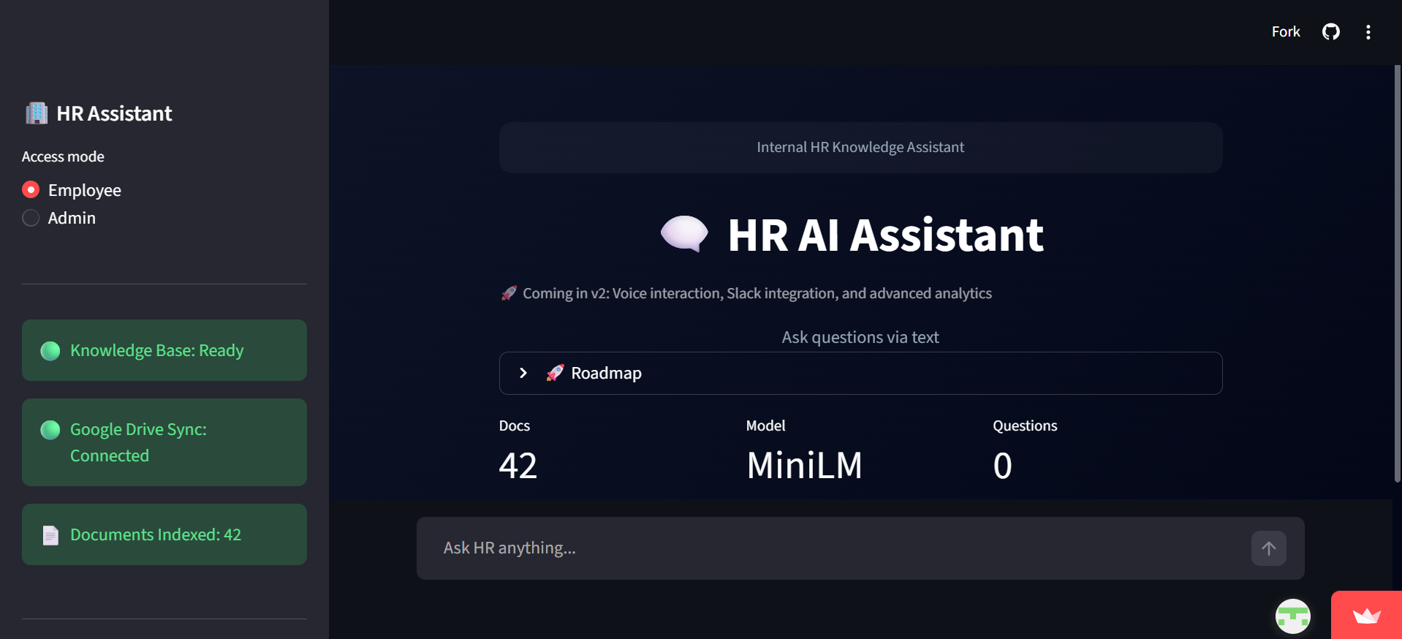
Live System Preview

Slide 7
How It Works
User → Ask Question
↓
FAISS → Find Relevant Docs
↓
FLAN-T5 → Generate Answer
↓
Response → Display to User

Slide 8
Tech Stack
Streamlit (UI)
Transformers (FLAN-T5)
LangChain (Pipeline)
FAISS (Search)
Google Drive (Data)

Slide 9
Data Pipeline
Load documents
Split into chunks
Create embeddings
Store in FAISS

Slide 10
User Modes
Employee: Ask questions
Admin: Upload & sync documents

Slide 11
Current Gaps
Depends on document quality
No voice yet
No authentication

Slide 12
What’s Next (V2)
Voice interaction
Slack / Teams integration
Authentication
Advanced analytics

Slide 13
Business Impact
Saves HR time
Improves efficiency
Reduce HR workload
Centralizes knowledge
HR Assistant AI transforms how organizations access internal knowledge.

Slide 14
Thank You
Questions?

